Slide 1

IBM Cloud using Watson Studio
Upload Road Accident data to Jupyter Notebook in and create a dashboard.
Project by:-
Smart Defenders
(Archana Kumari)
Guide by:-Ms Arpita Roy

Slide 2
CONTENT
 | Title
1 | Problem Statement
2 | Project Overview
3 | Why We need this?
4 | How it will help people?
5 | Solution
6 | How it’s unique
7 | Modeling
8 | Result(Prediction Model)

Slide 3
Problem Statement
Address the challenge of road safety by leveraging IBM Cloud with Watson Studio to upload accident data into a Jupyter Notebook, creating an insightful dashboard for analysis.
accidents have been a major concern from 2017 to 2022,
causing harm and damage. To make our roads safer, we need
to analyze the accident data during these years. By
studying the patterns and reasons behind these accidents,
we aim to find ways to prevent them and enhance safety
measures for everyone on the road.

Slide 4
Project overview
Our goal is to create a platform that would evaluate and predict the data of Road accident , so we started with Jupiter notebook and gathered data, filtered it, then moved on to visualisation, and eventually created a prediction model for this data set
Improve road safety insights by uploading accident data to Jupyter Notebook using IBM Cloud with Watson Studio and creating a dashboard for efficient analysis.

Slide 5
Why we need this?
Preventing Future Accidents
Policy Improvements
Saving Lives
Public Awareness
Infrastructure Enhancement
Continuous Improvement

Slide 6
How it will help people?
Improves road safety by leveraging IBM Cloud with Watson Studio to
analyze and visualize accident data in a Jupyter Notebook dashboard
aiding informed decision-making.
Road accident data analytics aids in prevention,
response, and policymaking, enhancing road safety by
identifying high-risk areas, improving emergency services,
shaping effective policies, and promoting
awareness, ultimately reducing accidents and saving lives.

Slide 7
Our solution to analyse data
.
Utilizes IBM Cloud with Watson Studio to upload road accident data into Jupyter Notebook, creating a dashboard for streamlined data analysis.
Utilize advanced analytics and machine learning to analyze road accident data.
Implement predictive analytics using machine learning algorithms on road accident data to identify patterns, assess risk factors, and develop proactive measures for road safety
Implement preventive measures, improve road infrastructure, and enhance public awareness for targeted road safety

Slide 8
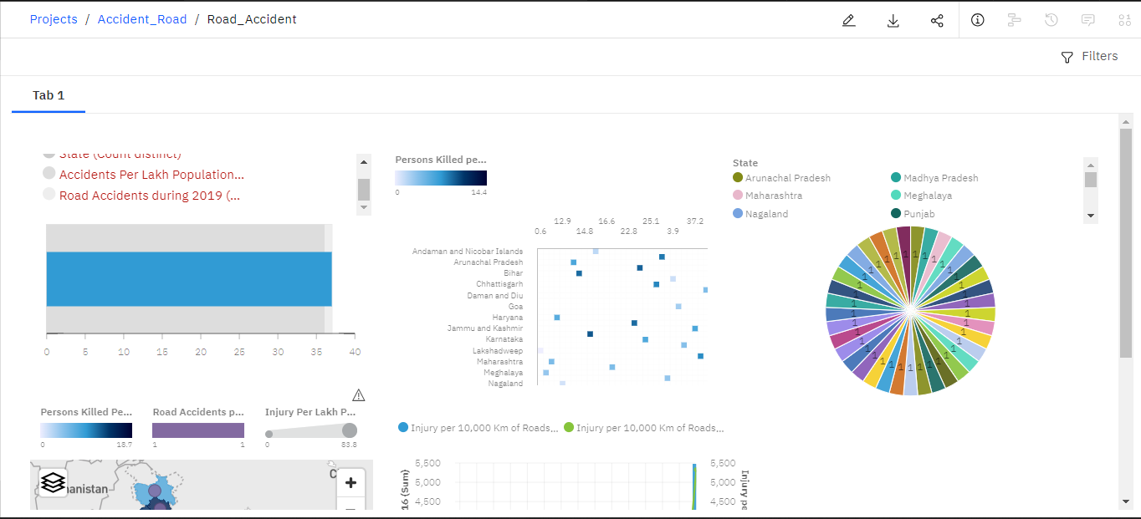
Our solution to analyse data (contd)

Slide 9
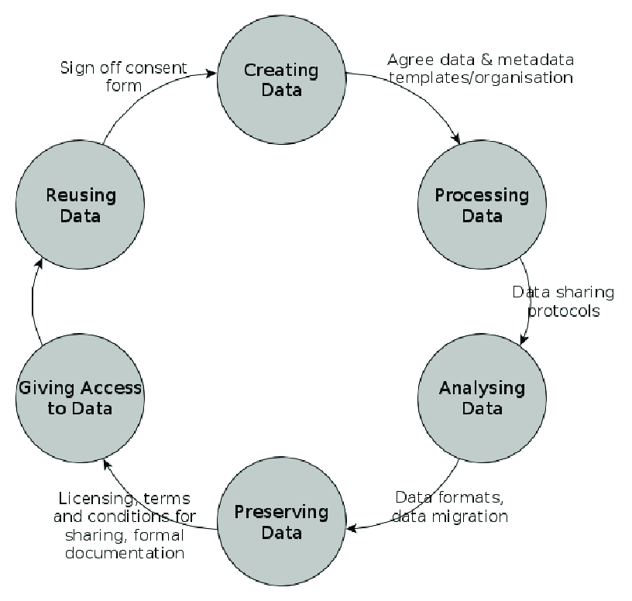
Modeling(Analysis model)

Slide 10
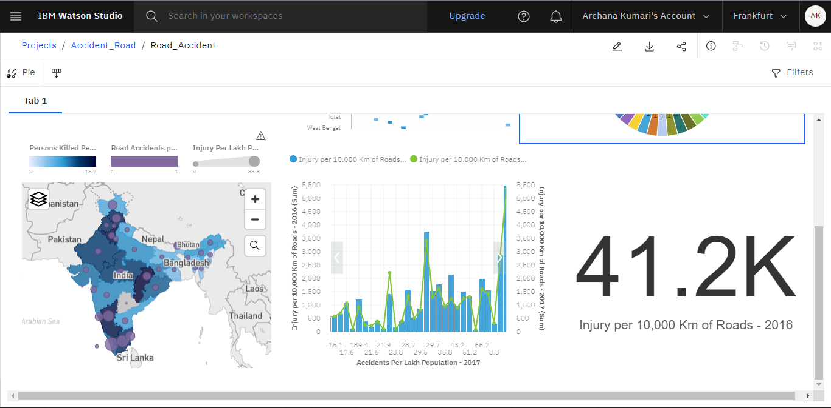
Result
Successfully integrated IBM Cloud and Watson Studio to upload road accident data into Jupyter Notebook, creating an insightful dashboard for analysis.The provided code generates a line plot to visually analyze the trend in the number of persons killed in road accidents across different states from 2017 to 2020. The plot displays how the number of fatalities has changed over these years, with each year represented by a different line. The x-axis shows the states, and the y-axis represents the number of persons killed. The legend helps identify the year associated with each line. This visualization aids in assessing and comparing the road accident data trends for different states over the specified time period.

Slide 11
Thank
you

